Slide 1
Predicting Winners of NHL Games with Machine Learning in R
By Michael Starbuck
Regis University MSDS 696 – Data Science Practicum II

Slide 2
Introduction
Over 10,000 games were played in the NHL between the 2008-09 and 2017-18 seasons
Box scores included standard statistics for each of those games
Are those stats useful in telling the story of the game? Can the winner be predicted from those stats alone?

Slide 3

Data Summary
Data was found on the NHL website
URL: http://www.nhl.com/stats
Data is very clean thanks to a six-year project that rolled out in 2017. Detail found here https://www.nhl.com/news/nhl-historical-stats-now-available/c-291389804
Regular season, home games used
After initial cleaning there were 11,831 rows with 31 variables including the class variable, wins

Slide 4
Scraping Data
Data on NHL.com broken out into categories
Multiple categories scraped and joined together
Duplicate columns were created that needed to be eliminated
30 Variables plus wins (class) variable

Slide 5
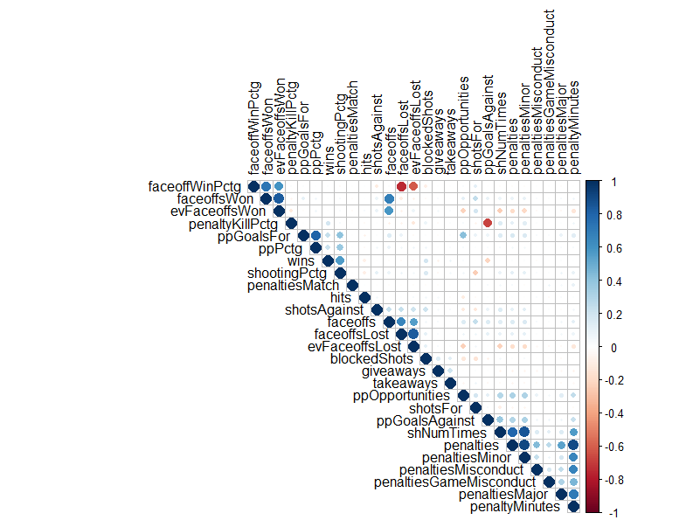
Data Exploration
No NA or missing values
Correlation plot revealed minor correlations between columns that can be derived from others
About 55% of rows have a class of 1 (win) which shows a slight advantage for home teams

Slide 6
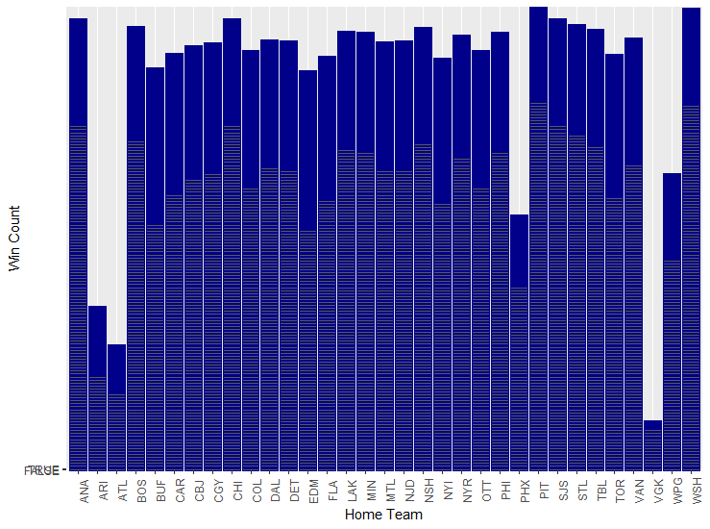
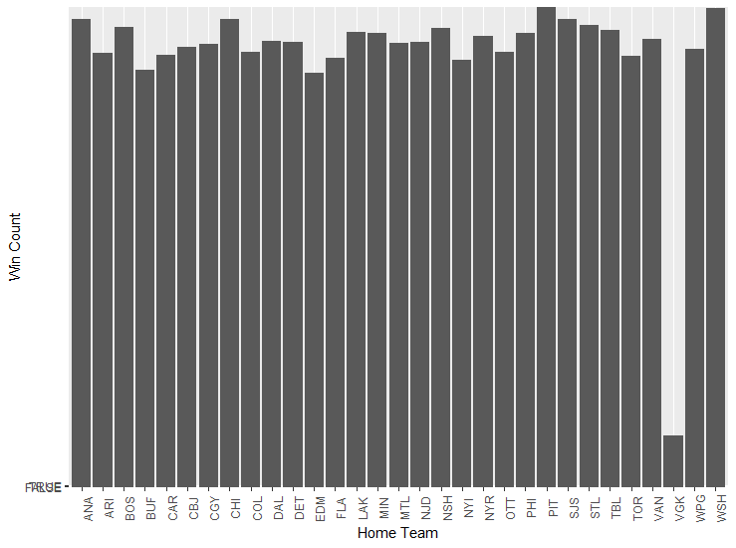
Exploring Team Names
Exploring team names to see if any team, or teams, has significantly more wins than others
ARI changed name to PHX and ATL moved to WPG
VGK only played one season, but no other significant differences

Slide 7
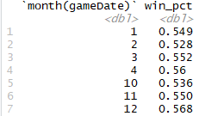

Exploring The Date Variable
First attempt is to group dates into early, mid and late season with no significant difference in win percentage
Group by months with some variation so it may be worth keeping month

Slide 8
Building the Models
Two methods will be utilized
Support Vector Machine (SVM) from the e1071 package
Artificial Neural Network (ANN) from the nnet package
Best performing model will be selected and parameters tuned
Accuracy will be used to determine performance
Not concerned about a particular type of error, only minimizing error in general
70/30% split of data for train/test

Slide 9

SVM Model Performance
Radial kernel and gamma = 1/n were used as initial parameters
2,807 of the 3,473 test values were predicted correctly for an accuracy of 80.82%
Initially better than expected results

Slide 10

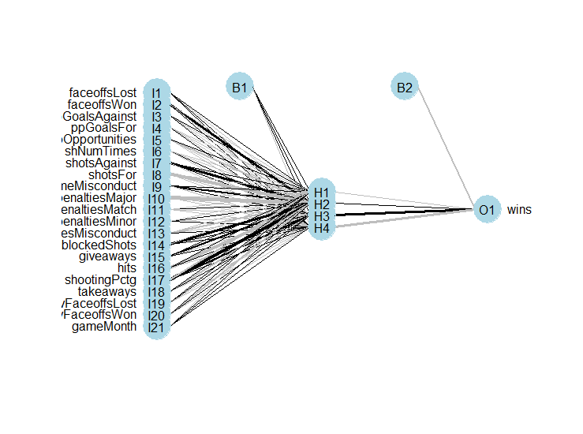
ANN Model Performance
Data was converted to numeric and normalized
Initial parameters were: size=4, rang=0.5, decay=5e-4 and maxit=200
Mean Squared Error was 0.128
Accuracy is higher than SVM at 81.14%
This model selected for fine-tuning

Slide 11
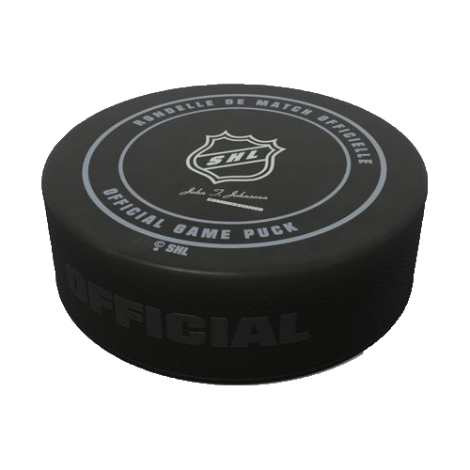
Optimization of the ANN Model
Many attempts were made at adjusting parameters with little to no change to the accuracy
Decreasing rang -> 80.4%
Increasing rang -> 80.7%
Even higher rang -> 80.6%
Increase size -> 77.7%
Decrease size -> 80.9%
Increase max iterations -> 80.5%
Increase decay -> 80.5%
Increase decay less -> 80.3%
No decay -> 79.8%

Slide 12
Fine-Tuning Variables
Using the highest performing ANN model set-up
Add team name one-hot encoded
80.1% accuracy
Remove months variable
80.6% accuracy

Slide 13
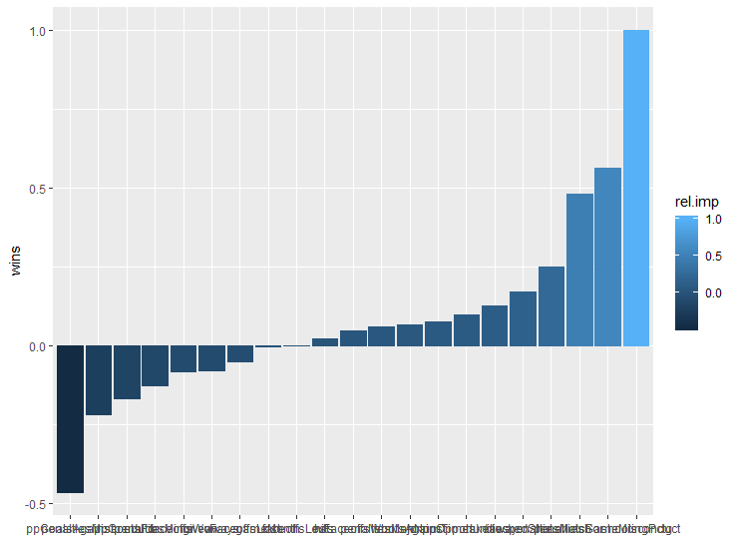
Variable Importance
Credit to Matthew Beck and his blog post https://www.r-bloggers.com/variable-importance-in-neural-networks/
High importance – Shooting percentage, game misconduct penalties and shots for
Low importance – Faceoffs lost, game month and hits
Game misconduct and match penalties have a positive correlation which is very surprising

Slide 14
Conclusion
The box score statistics do tell the story of the game
Faceoffs won and lost have very little impact on determining the winner
Penalties and power plays have a big role in determining the outcome
Other advanced stats may help increase the accuracy but not explored here

Slide 15
REferences
Beck, M.W. (August 12, 2013) Variable Importance in neural networks. R-bloggers.
Retrieved from
https://www.r-bloggers.com/variable-importance-in-neural-networks/
Koshy, J. (Nov 11, 2016) Web scraping: Best practices to follow. Prompt Cloud.
Retrieved from
https://www.promptcloud.com/blog/web-scraping-best-practices
NHL.com (2018) NHL.com/stats. Teams game by game results. Retrieved from
http://www.nhl.com/stats/team?reportType=game&dateFrom=2008-10-01&dateTo=2018-04-30&gameType=2&gameLocation=H&filter=gamesPlayed,gte,1&sort=points,wins
ProgrammingR (2018) “Web scraping R data from JSON”. Retrieved from
http://www.programmingr.com/examples/reading-json-data/

